Slide 1

An Introduction to C# and the .NET Framework

Slide 2
A Workshop Presented by
Dr. Stewart B. Carpenter and
Dr. Catherine Stringfellow

Slide 3
Workshop Outline
Introduction to .NET
Introduction to .NET IDE
C# console application
Differences in C# and C++
Break
C# Windows Application (SDI)
C# Windows Application (MDI)

Slide 4
References
Deitel, H., Deitel, P., et al., C#, How to Program, Prentice-Hall, Upper Saddle River, NJ
Foxall, J. and Haro-Chun, W., SAMS Teach Yourself C# in 24 Hours, SAMS, Indianapolis, IN
Turtschi, A., et al., C# .NET Web Developer’s Guide, Syngress, electronic volume at www.netlibrary.com
Workshop slides and tutorial materials can be downloaded from:
http://cs.mwsu.edu/~stringfe/CCSCWorkshop

Slide 5
.NET and C#
.NET Platform
Web-based applications can be
distributed to a variety of devices
and desktops
C#
developed specifically for .NET

Slide 6
Introduction to Microsoft .NET
.NET initiative
  Introduced by Microsoft (June 2000)
    Vision for embracing the Internet in software development
  Independence from specific language or platform
    Applications developed in any .NET-compatible language
      Visual Basic.NET, Visual C++.NET, C# and more
    Supports portability and interoperability
  Architecture capable of existing on multiple platforms
    Supports portability

Slide 7
Microsoft .NET
Key components of .NET
  Web services
    Applications used over the Internet
  Software reusability
    Web services provide solutions for variety of companies
      Cheaper than one-time solutions that can’t be reused
      Single applications perform all operations for a company via various Web services
        Manage taxes, bills, investments and more
    Pre-packaged components using Visual Programming
    (buttons, text boxes, scroll bars)
      Make application development quicker and easier

Slide 8
Microsoft .NET
Keys to interaction
  XML (Extreme Markup Language) and SOAP (Simple Object Access Protocol)
    “Glue” that combines various Web services to form applications
      XML gives meaning to data
      SOAP allows communication to occur easily

Slide 9
Microsoft .NET
Other concepts
  Universal data access
    Eliminates need to synchronize files
      Synchronization - Updating multiple copies of same file to the most recent
    Data resides at one central location
      Accessible by anyone with connection and proper authorization
    Data formatted appropriately for display on various devices
      Same document seen on PC, PDA, cell phone and other devices

Slide 10
.NET Framework and the Common Language Runtime
.NET Framework
  Heart of .NET strategy
    Manages and executes applications and Web services
    Provides security, memory management and other programming capabilities
  Includes Framework Class Library (FCL)
    Pre-packaged classes ready for reuse
    Used by any .NET language
  Details contained in Common Language Specification (CLS)
    Submitted to European Computer Manufacturers Association to make the framework easily converted to other platforms
  Executes programs by Common Language Runtime (CLR)

Slide 11
Common Language Runtime (CLR)
Central part of framework
  Executes programs
Compilation process
  Two compilations take place
    Programs compiled to Microsoft Intermediate Language (MSIL)
      Defines instructions for CLR
    MSIL code translated into machine code
      Platform-specific machine language

Slide 12
Common Language Runtime (CLR)
Why two compilations?
  Platform independence
    .NET Framework can be installed on different platforms
    Execute .NET programs without any modifications to code
    .NET compliant program translated into platform independent MSIL
  Language independence
    MSIL form of .NET programs not tied to particular language
    Programs may consist of several .NET-compliant languages
    Old and new components can be integrated
    MSIL translated into platform-specific code
Other advantages of CLR
  Execution-management features
    Manages memory, security and other features
      Relieves programmer of many responsibilities
      More concentration on program logic

Slide 13
.NET and C#
.NET platform
  Web-based applications can be distributed to variety of devices and desktops
C#
  Developed specifically for .NET
  Enable programmers to migrate from C/C++ and Java easily
  Event-driven, fully OO, visual programming language
  Has IDE
  Process of rapidly creating an application using an IDE is called Rapid Application Development (RAD)

Slide 14
C#
Language interoperability
  Can interact with software components written in different languages or with old packaged software written in C/C++
Can interact via internet, using industry standards (SOAP and XML)
  Simple Object Access Protocol - Helps to share program “chunks” over the internet
Accommodates a new style of programming in which applications are created from building blocks available over internet (reusability)

Slide 15
C# and the .NET IDE
Console applications
  No visual components
  (buttons, text boxes, etc.)
  Only text output
  Two types
    MS-DOS prompt -Used in Windows 95/98/ME
    Command prompt -Used in Windows 2000/NT/XP

Slide 16
Namespaces
Group related C# features into categories
Contain code that can be reused
.NET framework library (FCL) contains many namespaces
Must be referenced in order to be used
Example: Console feature is in
namespace System

Slide 17
Methods
Building blocks of C# programs
Every program is a class!
The Main method
  Each console or windows application must have exactly one

Slide 18

Simple Program: Output

Slide 19
1 //
2 // Printing a line with multiple statements.
3
4 using System;
5
6 class Welcome2
7 {
8 static void Main( string[] args )
9 {
10 Console.Write( "Welcome to " );
11 Console.WriteLine( "C# Programming!" );
12 }
13 }

Slide 20
Displaying output
  With C# →Console applications
    Text output only
    Console.Write(“... {0}”, Sum);
    Console.WriteLine(“…”);

Slide 21
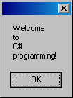
1 //
2 // Printing multiple lines in a dialog Box.
3
4 using System;
5 using System.Windows.Forms;
6
7 class Welcome4
8 {
9 static void Main( string[] args )
10 {
11 MessageBox.Show(“Welcome\nto\nC#\nprogramming!" );
12 }
13 }
The System.Windows.Forms namespace allows the programmer to use the MessageBox class.
This will display the contents in a message box as opposed to in the console window.

Slide 22
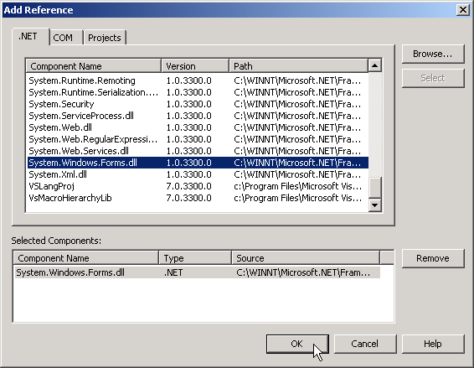
Adding a reference to an assembly in Visual Studio .NET
Add Reference dialogue

Slide 23
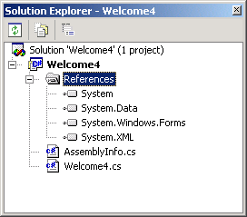
Adding a reference to an assembly in Visual Studio .NET
Solution Explorer
System.Windows.Forms reference
References folder

Slide 24

Dialog displayed by calling MessageBox.Show.
OK button allows the user to dismiss the dialog.
Close box
Dialog is automatically sized to accommodate its contents.
Mouse cursor

Slide 25
Getting input
Primitive data types built into C#
(string, int, double, char, long …15 types)
Console.ReadLine( )
  Used to get a value from the user input
Int32.Parse( )
  Converts a string argument to an integer
  Allows math to be performed once the string is converted
number2 = Int32.Parse( Console.ReadLine( ) );

Slide 26
1 //
2 // A first console program in C#.
3
4 using System;
5
6 class Welcome1
7 {
8 static void Main( string[] args )
9 {
10 Console.WriteLine( "Welcome to C# Programming!" );
11 }
12 }

Slide 27
1 //
2 // An addition program.
3
4 using System;
5
6 class Addition
7 {
8 static void Main( string[] args )
9 {
10 string firstNumber, // first string entered by user
11 secondNumber; // second string entered by user
12
13 int number1, // first number to add
14 number2, // second number to add
15 sum; // sum of number1 and number2
16
17 // prompt for and read first number from user as string
18 Console.Write( "Please enter the first integer: " );
19 firstNumber = Console.ReadLine();

Slide 28
21 // read second number from user as string
22 Console.Write( "\nPlease enter the second integer: " );
23 secondNumber = Console.ReadLine();
24
25 // convert numbers from type string to type int
26 number1 = Int32.Parse( firstNumber );
27 number2 = Int32.Parse( secondNumber );
28
29 // add numbers
30 sum = number1 + number2;
31
32 // display results
33 Console.WriteLine( "\nThe sum is {0}.", sum );
34
35 } // end method Main
36
37 } // end class Addition

Slide 29
Combining steps
21 // read second number from user as string
22 Console.Write( "\nPlease enter the second integer: " );
23 number2 = Int32.Parse( Console.ReadLine() );

